Slide 1

CS 4593/6463 – Bitcoins and Cryptocurrencies
Prof. Murtuza Jadliwala
murtuza.jadliwala@utsa.edu
Note: most of the slides used in this course are derived from those available for the book “Bitcoins and Cryptocurrencies Technologies – A Comprehensive Introduction”, Arvind Narayanan, Joseph Bonneau, Edward Felten, Andrew Miller & Steven Goldfeder, 2016, Princeton University Press.

Slide 2
Lecture 3
Mechanics of Bitcoin

Slide 3
Recap: Bitcoin consensus
Bitcoin consensus gives us:
Append-only ledger
Decentralized consensus protocol
Miners to validate transactions
Assuming a currency exists to motivate miners!
In this chapter we will see how such a currency can be engineered
Notes:
But what rules?
Need to clarify what “append-only” means

Slide 4
Bitcoin transactions

Slide 5
An account-based ledger (not Bitcoin)
time
Create 25 coins and credit to Alice_{ASSERTED BY MINERS}
might need to scan backwards until genesis!
Transfer 17 coins from Alice to Bob_{SIGNED(Alice)}
Transfer 8 coins from Bob to Carol_{SIGNED(Bob)}
Transfer 5 coins from Carol to Alice_{SIGNED(Carol)}
is this valid?
Transfer 15 coins from Alice to David_{SIGNED(Alice)}
SIMPLIFICATION: only one transaction per block

Slide 6
A transaction-based ledger (Bitcoin)
Inputs: Ø
Outputs: 25.0→Alice No signature required
1
time
we implement this with hash pointers
change address
Inputs: 1[0]
Outputs: 17.0→Bob, 8.0→Alice
SIGNED(Alice)
2
Inputs: 2[0]
Outputs: 8.0→Carol, 7.0→Bob
SIGNED(Bob)
finite scan to check for validity
3
Inputs: 2[1]
Outputs: 6.0→David, 2.0→Alice
SIGNED(Alice)
4
is this valid?
SIMPLIFICATION: only one transaction per block
Notes:
This is called a “change address”

Slide 7
Merging value
time
Inputs: ...
Outputs: 17.0→Bob, 8.0→Alice
SIGNED(Alice)
1
...
Inputs: 1[1]
Outputs: 6.0→Carol, 2.0→Bob
SIGNED(Alice)
2
...
Inputs: 1[0], 2[1]
Outputs: 19.0→Bob
SIGNED(Bob)
3
SIMPLIFICATION: only one transaction per block

Slide 8
Joint payments
time
Inputs: ...
Outputs: 17.0→Bob, 8.0→Alice
SIGNED(Alice)
1
...
Inputs: 1[1]
Outputs: 6.0→Carol, 2.0→Bob
SIGNED(Alice)
2
...
Inputs: 2[0], 2[1]
Outputs: 8.0→David
SIGNED(Carol), SIGNED(Bob)
3
two signatures!
SIMPLIFICATION: only one transaction per block

Slide 9
The real deal: a Bitcoin transaction
{ "hash":"5a42590fbe0a90ee8e8747244d6c84f0db1a3a24e8f1b95b10c9e050990b8b6b", "ver":1, "vin_sz":2, "vout_sz":1, "lock_time":0, "size":404, "in":[ { "prev_out":{ "hash":"3be4ac9728a0823cf5e2deb2e86fc0bd2aa503a91d307b42ba76117d79280260", "n":0 },
"scriptSig":"30440..." }, { "prev_out":{ "hash":"7508e6ab259b4df0fd5147bab0c949d81473db4518f81afc5c3f52f91ff6b34e", "n":0 }, "scriptSig":"3f3a4ce81...." } ], "out":[ { "value":"10.12287097", "scriptPubKey":"OP_DUP OP_HASH160 69e02e18b5705a05dd6b28ed517716c894b3d42e OP_EQUALVERIFY OP_CHECKSIG" } ]
}
metadata
input(s)
output(s)

Slide 10
The real deal: transaction metadata
{ "hash":"5a42590...b8b6b", "ver":1, "vin_sz":2, "vout_sz":1, "lock_time":0, "size":404,
...
}
also serves as a unique ID
transaction hash
housekeeping
“not valid before”
more on this later...
housekeeping

Slide 11
The real deal: transaction inputs
"in":[ { "prev_out":{ "hash":"3be4...80260", "n":0 },
"scriptSig":"30440....3f3a4ce81" }, ...
],
previous
transaction
signature
(more inputs)

Slide 12
The real deal: transaction outputs
"out":[
{
"value":"10.12287097",
"scriptPubKey":"OP_DUP OP_HASH160 69e...3d42e OP_EQUALVERIFY OP_CHECKSIG"
},
...
]
output value
recipient address??
more on this soon...
(more outputs)
Sum of all output values less than or equal to sum of all input values!
If sum of all output values less than sum of all input values, then difference goes to miner as a transaction fee

Slide 13
Bitcoin scripts

Slide 14
Output “addresses” are really scripts
OP_DUP
OP_HASH160
69e02e18...
OP_EQUALVERIFY OP_CHECKSIG

Slide 15
Input “addresses” are also scripts
(from the redeeming transaction)
30440220...
0467d2c9...
scriptSig
(from the transaction being redeemed)
OP_DUP
OP_HASH160
69e02e18...
OP_EQUALVERIFY OP_CHECKSIG
scriptPubKey
TO VERIFY: Concatenated script must execute completely with no errors

Slide 16
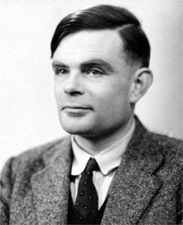

Bitcoin scripting language (“Script”)
Design goals
Built for Bitcoin (inspired by Forth)
Simple, compact
Support for cryptography
Stack-based (linear)
Limits on time/memory
No looping
Result: Bitcoin script is not Turing Complete!
i.e, cannot compute arbitrarily powerful
functions
Advantage: No infinite looping problem!
I am not impressed
image via Jessie St. Amand

Slide 17
Bitcoin scripting language (“Script”)
256 instructions (each represented by 1 byte)
75 reserved, 15 disabled
Basic arithmetic, basic logic (“if” → “then”), throwing errors, returning early, crypto instructions (hash computations, signature verifications), etc.
Only two possible outcomes of a Bitcoin script
Executes successfully with no errors → transaction is valid OR
Error while execution → transaction invalid and should not be accepted in the block chain

Slide 18
Common script instructions
Name | Functions
OP_DUP | Duplicates top item on the stack
OP_HASH160 | Hashes twice: first using SHA-256, then using RIPEMD-160
OP_EQUALVERIFY | Returns true if inputs are equal, false (marks transaction invalid) otherwise
OP_CHECKSIG | Checks that the input signature is valid using input public key for the hash of the current transaction
OP_CHECKMULTISIG | Checks that t signatures on the transaction are valid from t (out of n) of the specified public keys

Slide 19

OP_CHECKMULTISIG
Built-in support for joint signatures
Specify n public keys
Specify t
Verification requires t signatures are valid
BUG ALERT: Extra data value popped from the stack and ignored

Slide 20
Bitcoin script execution example
✓
<pubKeyHash?>
<pubKey>
<pubKeyHash>
<pubKey>
<sig>
true
<sig> <pubKey> OP_DUP OP_HASH160 <pubKeyHash?> OP_EQUALVERIFY OP_CHECKSIG

Slide 21
Bitcoin scripts in practice (as of 2014)
Most nodes whitelist known scripts
99.9% are simple signature checks
~0.01% are MULTISIG
~0.01% are Pay-to-Script-Hash
Remainder are errors, proof-of-burn
More on this soon

Slide 22
Proof-of-burn
nothing’s going to redeem that ☹
OP_RETURN
<arbitrary data>
Notes:
Uses: spam/griefing. Transfer to another cryptocurrency. Fidelity bond

Slide 23
Should senders specify scripts?
?
Big Box
I’m ready to pay for my purchases!
Cool! Well we’re using MULTISIG now, so include a script requiring 2 of our 3 account managers to approve. Don’t get any of those details wrong. Thanks for shopping at Big Box!

Slide 24
Idea: use the hash of redemption script
<signature>
<<pubkey> OP_CHECKSIG>
<signature>
<pubkey>
OP_CHECKSIG
OP_HASH160
<hash of redemption script>
OP_EQUAL
“Pay to Script Hash”

Slide 25
Pay to script hash
Big Box
I’m ready to pay for my purchases!
Great! Here’s our address: 0x3454

Slide 26
Applications of Bitcoin scripts

Slide 27

Example 1: Escrow transactions
(disputed case)
(normal case)
Pay x to Bob
SIGNED(ALICE, BOB)
Pay x to Alice
SIGNED(ALICE, JUDY)
Judy
To: Alice
From: Bob
PROBLEM: Alice wants to buy online from Bob. Alice doesn’t want to pay until after Bob ships.
Bob doesn’t want to ship until after Alice pays.
Alice
Pay x to 2-of-3 of Alice, Bob, Judy (MULTISIG)
SIGNED(ALICE)
Bob
Notes:
Gavel from OpenClipArt.com

Slide 28
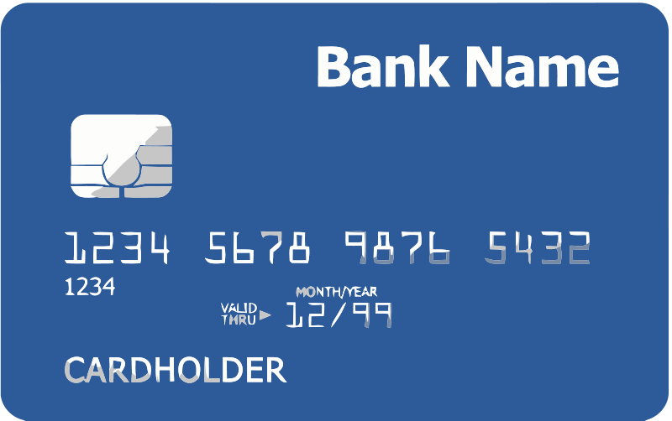

Example 2: Green addresses
004 days since last double spend!
It’s me, Alice! Could you make out a green payment to Bob?
Faraday cage
Bank
Pay x to Bob, y to Bank
SIGNED(BANK)
No double spend
Alice
PROBLEM: Alice wants to pay Bob.
Bob can’t wait 6 verifications to guard against double-spends, or is offline completely.
Bob
Notes:
These are mostly dead thanks to Mt. Gox, Instawallet

Slide 29
Example 3: Efficient micro-payments
What if Bob never signs??
Input: x; Pay 42 to Bob, 58 to Alice
SIGNED(ALICE) SIGNED(BOB)
all of these could be double-spends!
Input: x; Pay 42 to Bob, 58 to Alice
SIGNED(ALICE)___________
...
Alice demands a timed refund transaction before starting
Input: x; Pay 04 to Bob, 96 to Alice
SIGNED(ALICE)___________
Input: x; Pay 100 to Alice, LOCK until time t
SIGNED(ALICE) SIGNED(BOB)
I’m done!
I’ll publish!
Input: x; Pay 03 to Bob, 97 to Alice
SIGNED(ALICE)___________
Input: x; Pay 02 to Bob, 98 to Alice
SIGNED(ALICE)___________
Input: x; Pay 01 to Bob, 99 to Alice
SIGNED(ALICE)___________
PROBLEM: Alice wants to pay Bob for each minute of phone service. She doesn’t want to incur a transaction fee every minute.
Bob
Alice
Input: y; Pay 100 to Bob/Alice (MULTISIG)
SIGNED(ALICE)
Notes:
What if Bob never paid?

Slide 30
lock_time
{ "hash":"5a42590...b8b6b", "ver":1, "vin_sz":2, "vout_sz":1, "lock_time":315415, "size":404,
...
}
Block index or real-world timestamp before which this transaction can’t be published

Slide 31
More advanced scripts
Multiplayer lotteries
Hash pre-image challenges
Coin-swapping protocols
Don’t miss the lecture on anonymity!
“Smart contracts”

Slide 32
Bitcoin blocks

Slide 33
Bitcoin blocks
Why bundle transactions together?
Single unit of work for miners
Limit length of hash-chain of blocks
Faster to verify history

Slide 34
Bitcoin block structure
Hash chain of blocks
prev: H( )
prev: H( )
prev: H( )
trans: H( )
trans: H( )
trans: H( )
H( ) H( )
Hash tree (Merkle tree) of transactions in each block
H( ) H( )
H( ) H( )
transaction
transaction
transaction
transaction

Slide 35
The real deal: a Bitcoin block
{
"hash":"00000000000000001aad2...",
"ver":2,
"prev_block":"00000000000000003043...",
"time":1391279636,
"bits":419558700,
"nonce":459459841,
"mrkl_root":"89776...",
"n_tx":354,
"size":181520,
"tx":[
...
],
"mrkl_tree":[
"6bd5eb25...",
...
"89776cdb..."
]
}
block header
transaction data

Slide 36
The real deal: a Bitcoin block header
{
"hash":"00000000000000001aad2...",
"ver":2,
"prev_block":"00000000000000003043...",
"time":1391279636,
"bits":419558700,
"nonce":459459841,
"mrkl_root":"89776...",
...
}
mining puzzle information
hashed during mining
not hashed

Slide 37
The real deal: coinbase transaction
"in":[ { "prev_out":{ "hash":"000000.....0000000", "n":4294967295 },
"coinbase":"..." }, "out":[ { "value":"25.03371419", "scriptPubKey":"OPDUP OPHASH160 ... ”
}
Null hash pointer
redeeming nothing
First ever coinbase parameter:
“The Times 03/Jan/2009 Chancellor on brink of second bailout for banks”
arbitrary
block reward
transaction fees

Slide 38
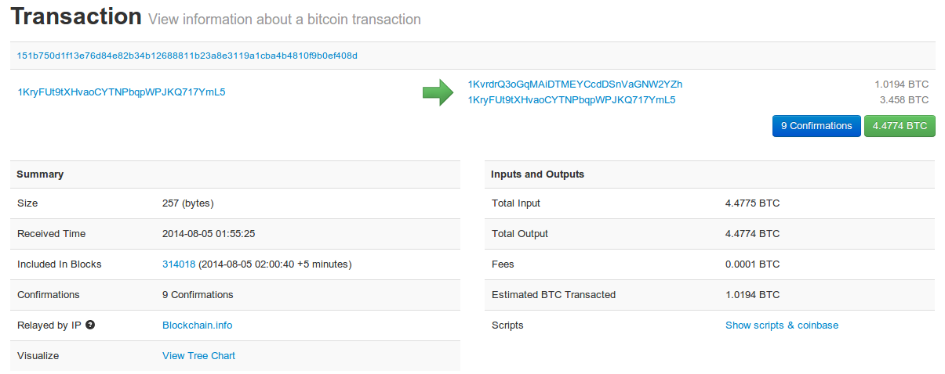
See for yourself!
blockchain.info (and many other sites)

Slide 39
The Bitcoin network

Slide 40
Bitcoin P2P network
Ad-hoc protocol (runs on TCP port 8333)
Ad-hoc network with random topology
All nodes are equal
New nodes can join at any time
Forget non-responding nodes after 3 hr

Slide 41
Joining the Bitcoin P2P network
5
1
Hello World! I’m ready to Bitcoin!
7
8
getaddr()
getaddr()
1, 7
getaddr()
3
6
2
4
Notes:
No geographic topology
Seed nodes
No formal way of leaving

Slide 42
Transaction propagation (flooding)
Already heard that!
5
1
7
8
A→B
A→B
A→B
3
6
A→B
New tx!
A→B
2
A→B
A→B
A→B
A→B
4
A→B
A→B
Notes:
Transactions are propagated in the “pending transaction pool”

Slide 43
Should I relay a proposed transaction?
Transaction valid with current block chain(default)
Run script for each previous output being redeemed and ensure that script returns true!
Script matches a whitelist
Avoid unusual scripts
Haven’t seen before
Avoid infinite loops
Doesn’t conflict with others I’ve relayed
Avoid double-spends
Sanity checks only...
Well-behaving nodes implement them!
Some nodes may ignore them!

Slide 44
Nodes may differ on transaction pool
New tx!
A→C
5
1
A→C
A→B
A→C
7
A→C
A→C
8
A→C
A→B
A→B
A→B
3
6
2
A→B
A→B
A→B
4
A→B

Slide 45
Race conditions
Transactions or blocks may conflict
Default behavior: accept what you hear first
Network position matters
Miners may implement other logic!
Stay tune for the lecture on mining!

Slide 46
Block propagation nearly identical
Relay a new block when you hear it if:
Block meets the hash target
Block has all valid transactions
Run all scripts, even if you wouldn’t relay
Block builds on current longest chain
Avoid forks
Sanity check
Also may be ignored...

Slide 47
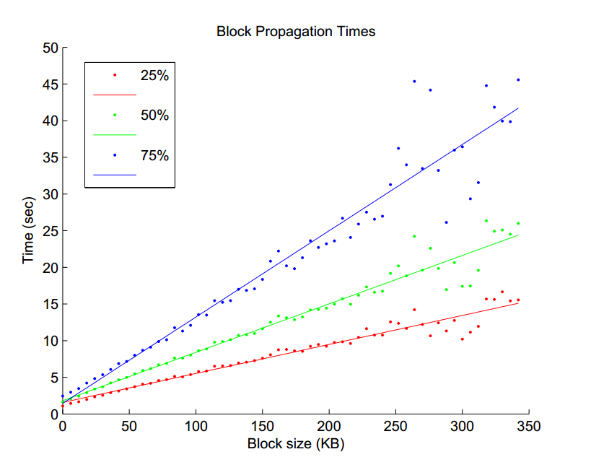
Source: Yonatan Sompolinsky and Aviv Zohar: “Accelerating Bitcoin’s Transaction Processing” 2014

Slide 48
How big is the network?
Impossible to measure exactly
Estimates-up to 1M IP addresses/month
Only about 5-10k “full nodes”
Permanently connected
Fully-validate
This number may be dropping!

Slide 49
Fully-validating nodes
Permanently connected
Store entire block chain
Hear and forward every node/transaction

Slide 50
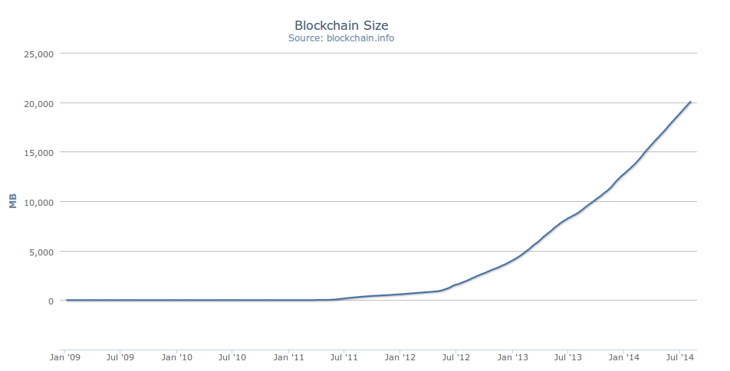
Storage costs (in 2014)
20 GB

Slide 51
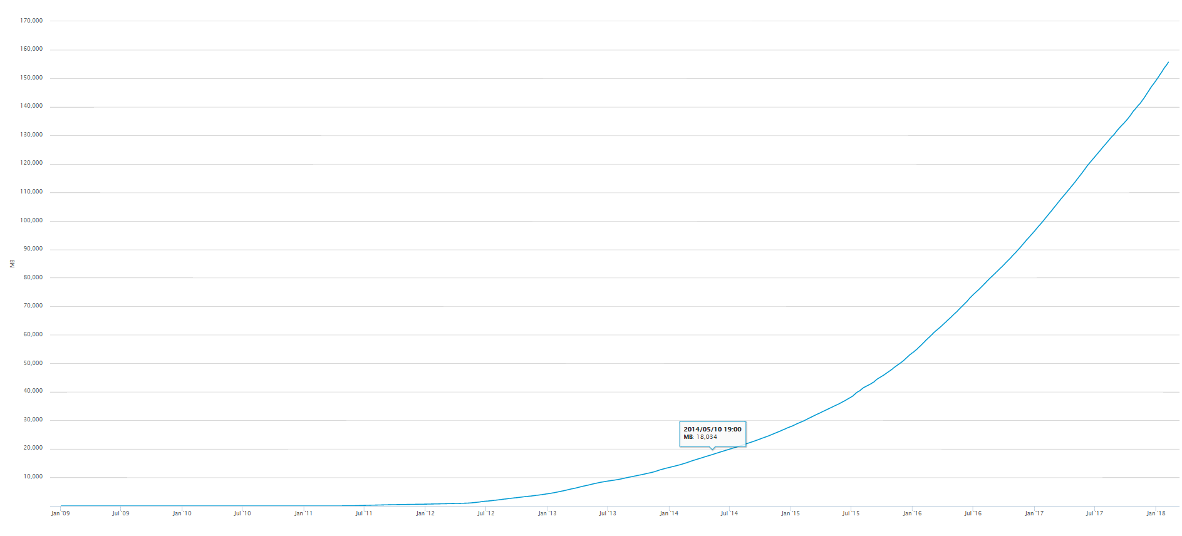
Storage costs (in 2018)
160 GB
Source: blockchain.info

Slide 52
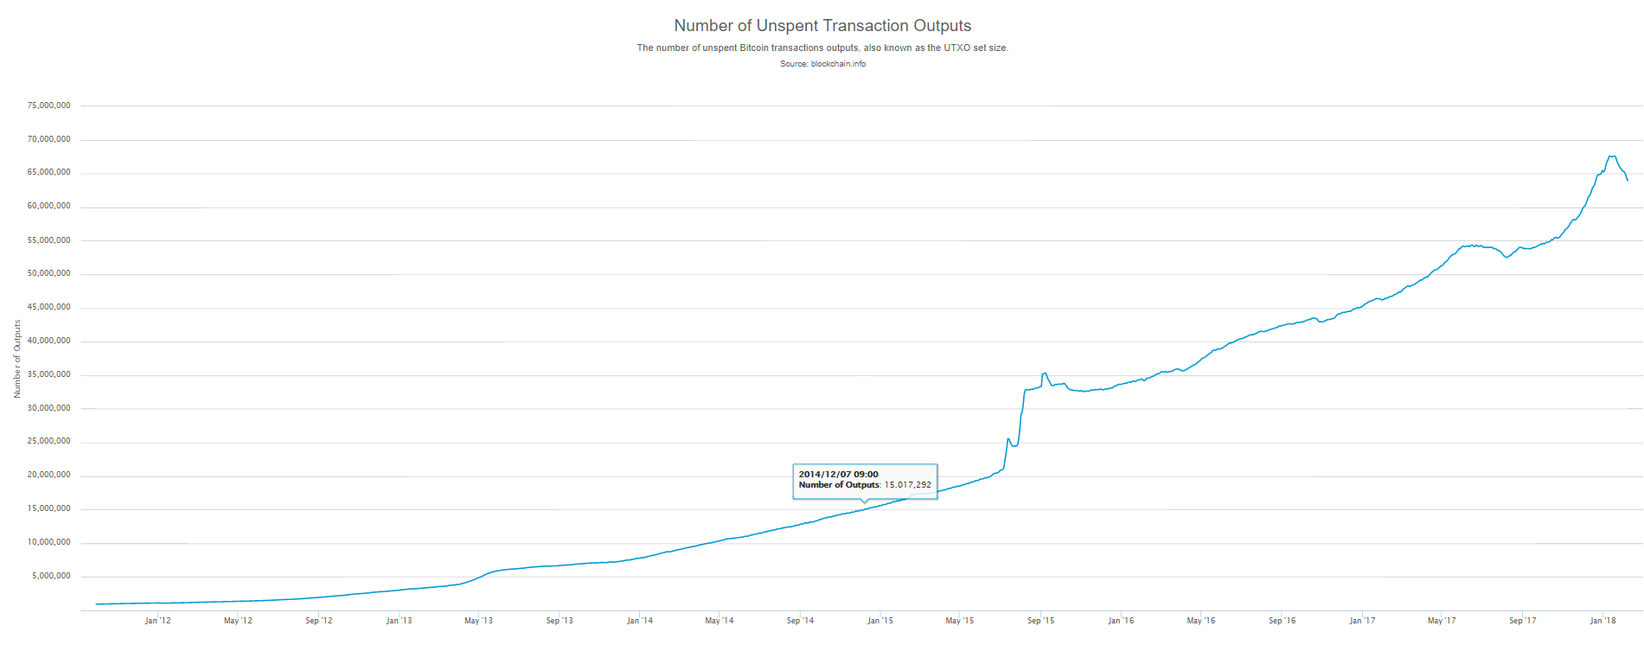
Tracking the UTXO set
Unspent Transaction Output
Should be stored in memory - everything else can be stored on disk, why?
65 M
Source: blockchain.info

Slide 53
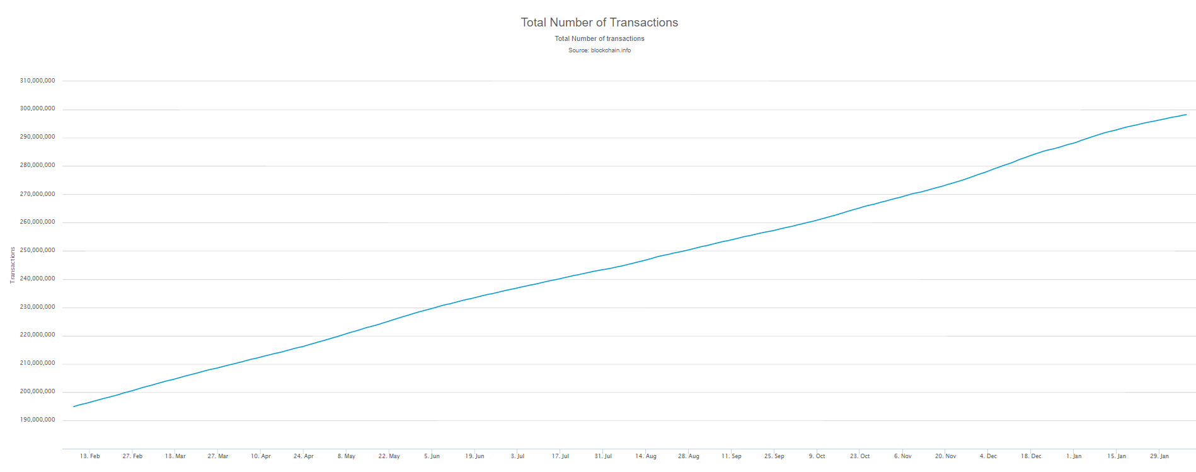
Tracking the UTXO set
Currently ~65 M UTXOs
Out of 300 M transactions
Can require several Gigabytes to store – can it fit in the RAM of a standard computer?
300 M
Source: blockchain.info

Slide 54
Thin/SPV clients (not fully-validating)
SPV – Simplified Payment Verification (e.g., Wallet nodes)
Idea: Don’t store everything
Store block headers – verify the puzzle was solved correctly, but cannot verify every transaction in each blocl!
Validate only those transactions that affect them → By requesting transactions as needed
To verify incoming payment
Trust fully-validating nodes
1000x cost savings! Requires only a few tens of Megabytes (compare to tens of Gigabytes needed for fully validating nodes)
Notes:
Also called “lightweight nodes”

Slide 55
Software diversity
About 90% of nodes run “Core Bitcoin” (C++)
Some are out of date versions
Other implementations running successfully
BitcoinJ (Java)
Libbitcoin (C++)
btcd (Go)
“Original Satoshi client”
Notes:
Core Bitcoin == “Satoshi “client
Original Satoshi client=historical only

Slide 56
Limitations & Improvements

Slide 57
Hard-coded limits in Bitcoin
10 min. average creation time per block
1 M bytes in a block
20,000 signature operations per block
100 M satoshis per bitcoin
23M total bitcoins maximum
50,25,12.5... bitcoin mining reward
These affect economic balance of power too much to change now

Slide 58
Throughput limits in Bitcoin
1 M bytes/block (10 min)
>250 bytes/transaction
7 transactions/sec ☹
Compare to:
VISA: 2,000-10,000 transactions/sec
PayPal: 50-100 transaction/sec

Slide 59
Cryptographic limits in Bitcoin
Only 1 signature algorithm (ECDSA/P256)
Hard-coded hash functions
Crypto primitives might break by 2040...

Slide 60
“Hard-forking” changes to Bitcoin
5
1
Block 23
Block 24
Block 23
7
8
Block 24
That’s crazy talk!!
Block 23
That’s crazy talk!!
Block 24
Block 23
24
I found a nifty new block!
3
6
24
2
Block 23
Block 24
Block 23
Block 23
24
4
24
Block 23
PROBLEM: Old nodes will never catch up
Block 24

Slide 61
Soft forks
Observation: we can add new features which only limit the set of valid transactions
Need majority of nodes to enforce new rules
Old nodes will approve
RISK: Old nodes might mine now-invalid blocks

Slide 62
Soft fork example: pay to script hash
<signature>
<<pubkey> OP_CHECKSIG>
OP_HASH160
<hash of redemption script>
OP_EQUAL
Old nodes will just approve the hash, not run the embedded script

Slide 63
Soft fork possibilities
New signature schemes
Extra per-block metadata
Shove in the coinbase parameter
Commit to UTXO tree in each block

Slide 64
Hard forks
New op codes
Changes to size limits
Changes to mining rate
Many small bug fixes
Currently seem very unlikely to happen
Stay tuned for the lecture on altcoins!

Slide 65
In the next lecture...

Slide 66
Human beings aren’t Bitcoin nodes
How do people interact with the network?
How do people exchange bitcoins for cash?
How do people securely store bitcoins?
Currency needs to work for people, not nodes

